Slide 1
ACCESSSS: working together to help Health Care Providers find EBM fast
Lori-ann Linkins MD, Msc(Clin Epi), FRCPC
Knowledge TraNslation Platform Lead, Hiru, Mcmaster

Slide 2
Appraise Medical literature
Focused data searches
Timely alert of interested parties

Slide 3
ACCESSSS
What we are hoping to achieve:
Provide rapid access to pre-appraised evidence
Reinforcement of using the Pyramid of Evidence to support clinical decisions
Support the practice of life-long learning
Encourage critical appraisal of local practice and standard-of-care

Slide 4
McMaster PLUS
New articles harvested from >120 journals from PubMed daily
Validated Boolean filters + Machine Learning
Step | Details | Articles/yr
Publication | 127 journals | 40,000
Literature search | Automated | 17,000
Quality screening | Manual | 4,000
Topic/discipline tagging | Manual | 4,000
Relevance/Newsworthiness | External | 3,600
Critical Appraisal by expert staff
Articles meeting criteria
Review by clinicians
PLUS
35+ disciplines
300+ topics
Turn around time: 14 days for 90% of content
HEALTH CARE PROFESSIONALS

Slide 5
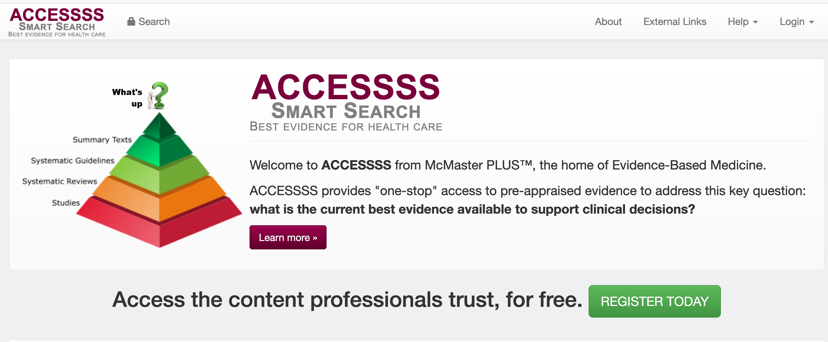
One-stop-search engine to find the current best evidence to support clinical decisions FAST!

Slide 6
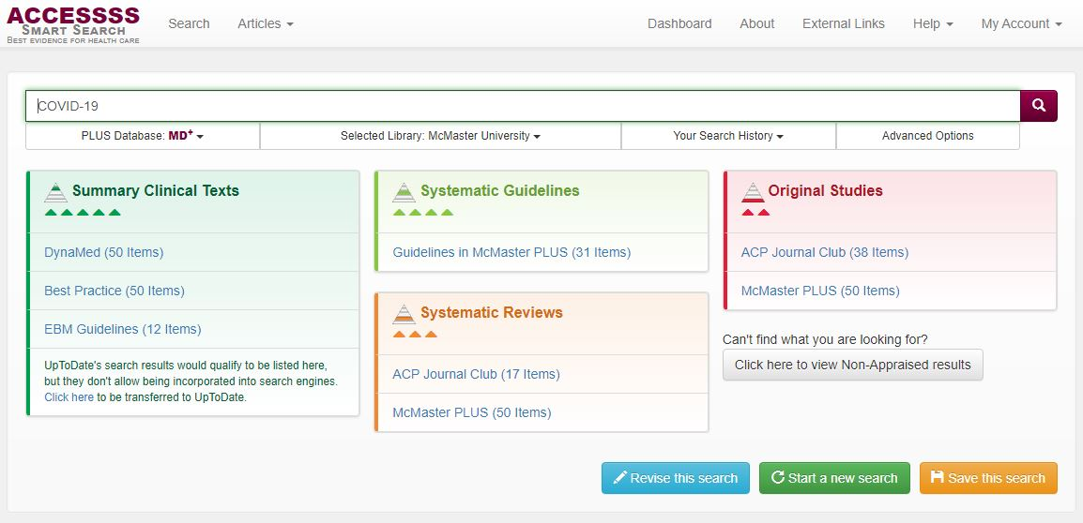
Second highest level of pyramid

Slide 10
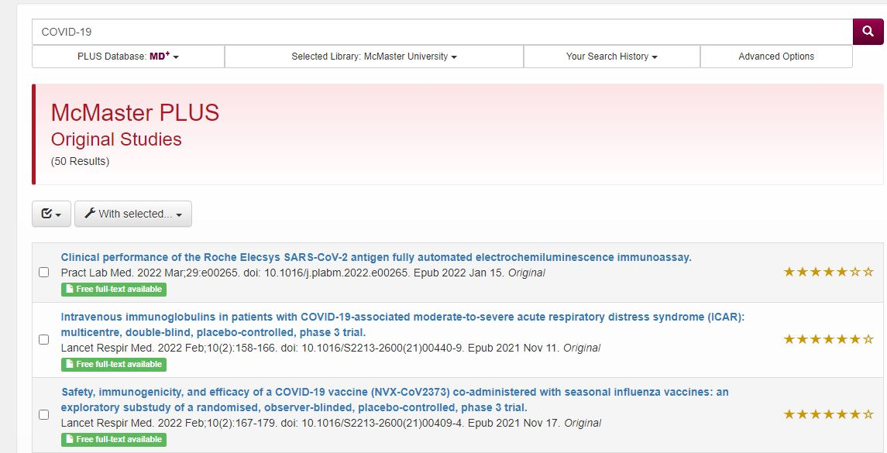
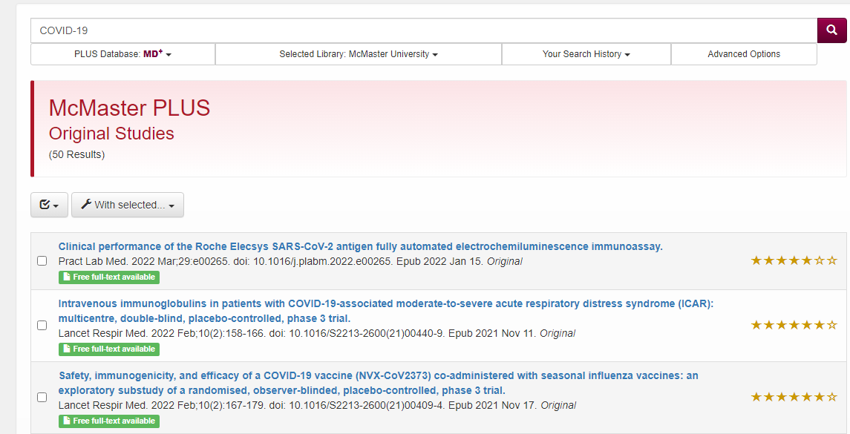
What do your peers think?

Slide 11
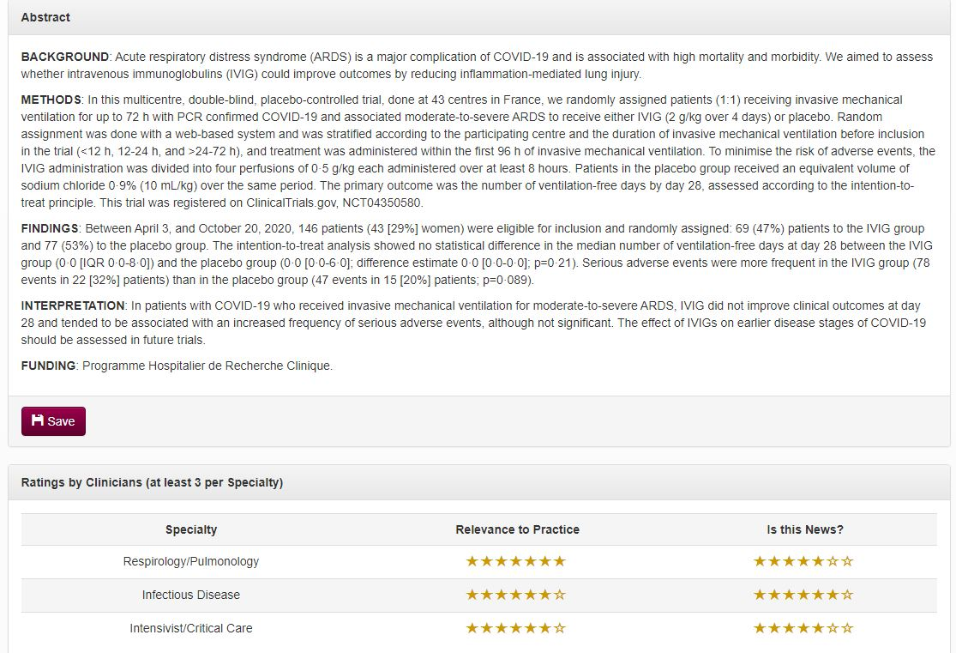
Peer (MORE) Ratings

