Slide 1

Pediatric Resident Research Program
Department of Pediatrics
University of British Columbia
Lori Tucker, MD, FRCPC
Clinical Professor in Pediatrics
Divsion of Rheumatology

Slide 2
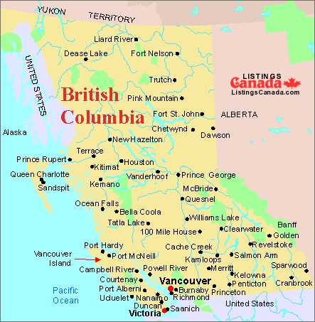
BC Children’s Hospital:
the tertiary care hospital for the province of BC

Slide 3
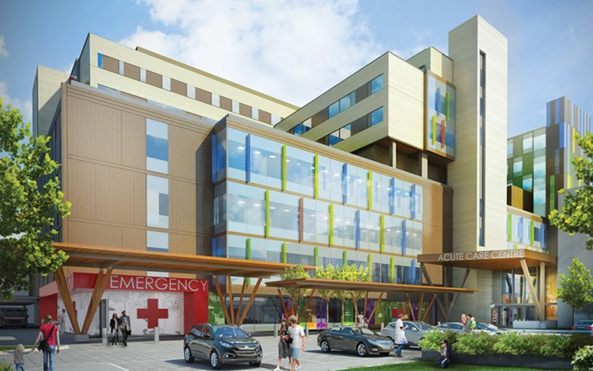
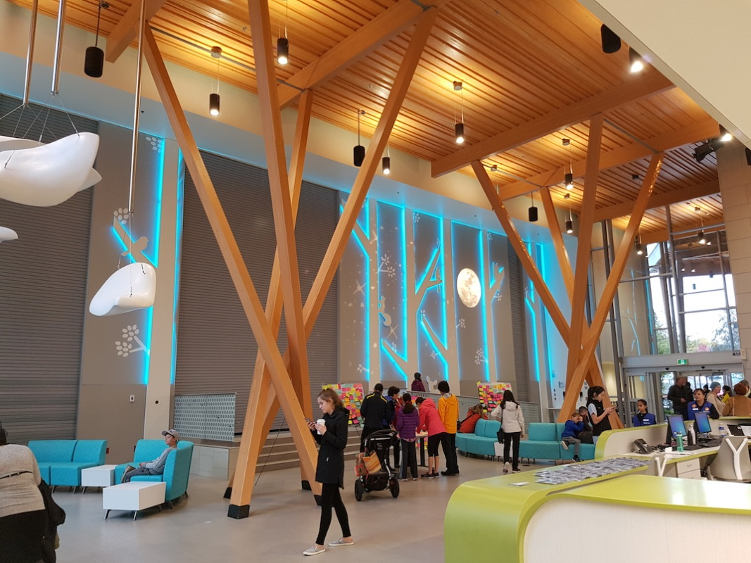
Our NEW hospital: The TECK Acute Care Building

Slide 4

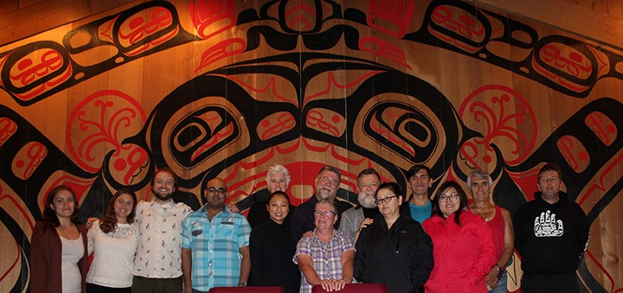
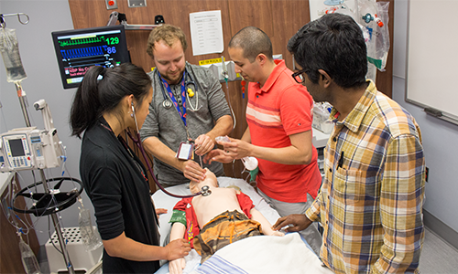
BCCH/UBC Pediatric Residency: Quick Facts
Total # residents: 60
2 sites: Vancouver and Victoria (2 residents/yr)
Approximately 50% go into general peds/50% subspecialty
Strong global health interest and initiatives

Slide 5
Resident Research Program Elements
Scholarly Project
Journal Club
Research Course
Research Blocks

Slide 6
Research at BCCH: where and who?
Clinical researchers- Divisions
BCCH Research Institute
  Bench and clinical research
Perinatal/ neonatal researchers- BC Women’s Hospital and RI
Centres
  Centre for Molecular Medicine and Therapeutics
  Injury Prevention Centre

Slide 7
Challenges…..
Poorly organized resident project tracking.
Resident Journal Club floundering.
Residents having trouble connecting to researchers on site.
Low profile of resident research program to faculty and other researchers.

Slide 8
Immediate changes…..
New administrative assistant.
Take stock and look at the BIG PICTURE.
Engage Resident Research Committee (X members) to help.
Get perspectives of Program Directors.

Slide 9
Resident Research Project Tracking
Shared Google spreadsheet.
Review by myself and admin monthly.
Routine communication to residents prior to any scheduled research block:
  Time block objectives, signed off by mentor.
Direct ‘reach out’ from me to any resident who was not meeting expectations.
  Project/mentor not identified.
  No visible progress on project.
  In danger of not completing on time.

Slide 10
Journal Club
Decrease # sessions from 9/yr to 7/yr:
  Skip Jan/Feb (low morale months for residents)
Maintain having evening sessions off site.
Strengthen connection between Faculty host and residents to select better articles.
Give direct guidance to Faculty hosts re: article selection, expectations of their role.
Residents given better guidance from their own representatives:
  Encouraged to select general ped relevant articles.
  Post Jclub article summary submitted and circulated to all residents.
2 articles/session: presenter and reader for each.

Slide 11
And how did it work out?
Doubled # attendees.
Increased participation by other staff/fellows.
Excellent reviews by residents.
Improved engagement in discussion (readers help with this).
Increasing skills in critical appraisal…maybe.

Slide 12
Resident Research Course
7 AHD sessions, generally sometime between Jan-March.
R1s required to attend.
Mix of skills-based topics and academic faculty discussing their career paths.
Course Director: Kevin Harris
Pre and post quiz
Continued tweaking of topics and speakers based on post course feedback.

Slide 13
Resident Research program events
Celebrate Research Day
  March, opening Grand Rounds talk
  Resident and fellow presentations and posters
CIP Manuscript Competition- submitted by Dept of Pediatrics
National Resident and Fellow Research Competition
Resident and Fellow Research Champion of the Year- awarded at the end of the year Dept Peds Banquet.

Slide 14
So much more to do…..
New administrator…
Institute standardized evaluation of resident research participation.
Increase capacity and training in QI research.
Develop a mentor support program.

Slide 15
